Slide 1

DIGITAL DETOX
A healthier relationship with technology
This Photo by Unknown Author is licensed under CC BY-NC
Presented by Ashfin Quadri | Bsc. Computer science 1st year

Slide 2
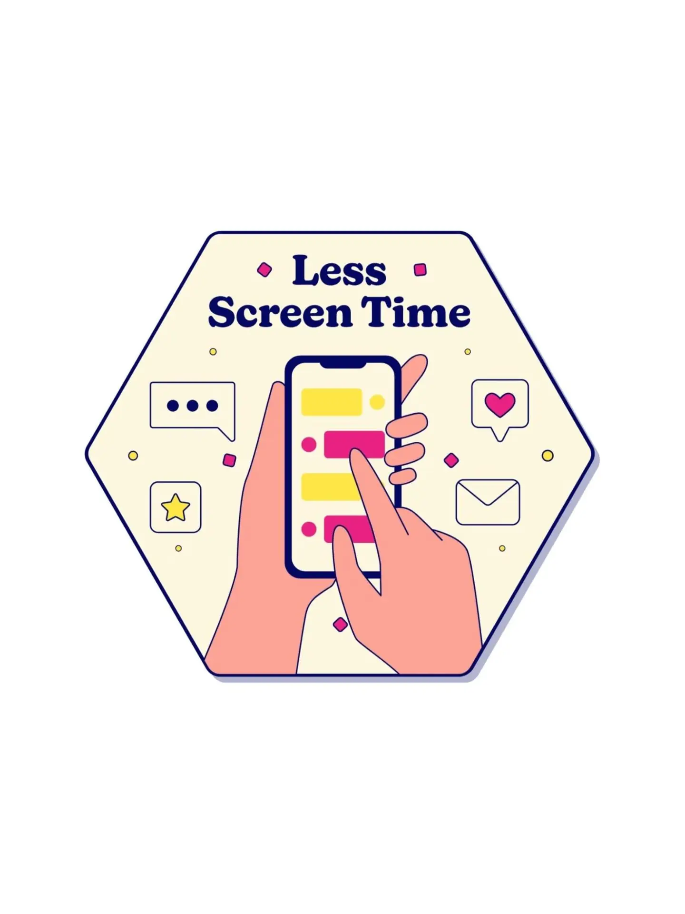
What is Digital Detox
Taking a short break from phones , apps, and screen
Digital Detox means reducing unnecessary screen time.
It helps us focus on real life activities.
The goal is balance – not giving up technology forever.

Slide 3
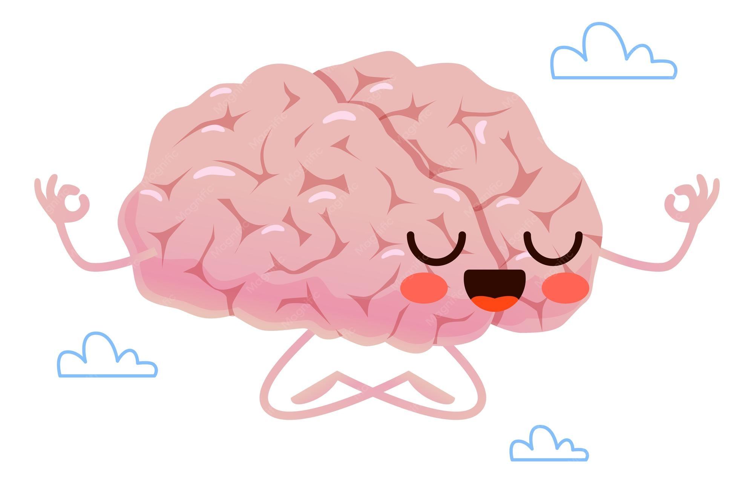
Why is Digital Detox Important
Too much screen time can affect your daily life.
May disturb sleep and reduce concentration.
Can make us feel stressed or distracted.
May reduce time spent with family and friends.
A break can improve focus and peace of mind.

Slide 4
Simple way to start a Digital Detox
Small habits can make a big difference
Keep your phone away while studying.

